Slide 1
PPO for WordZapper: Training AI to Play Atari Word Games
A practical guide to Proximal Policy Optimization

Slide 2
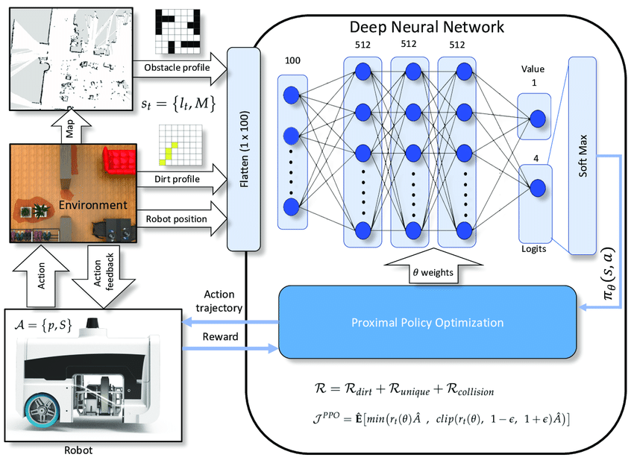
PPO

Slide 3
Why PPO?
Advantages over DQN:
Stable training with policy gradients.
Handles continuous/discrete actions.
Less sensitive to hyperparameters.
Key Features:
Clipped objective function (prevents drastic policy updates)
Actor-Critic architecture

Slide 4
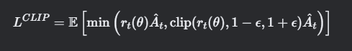
PPO Algorithm Overview
Mathematical Core:
Where::
rt(θ):Probability ratio of new vs old policy.
A^t: Advantage estimate.
ϵ: Clip range (typically 0.2).

Slide 5
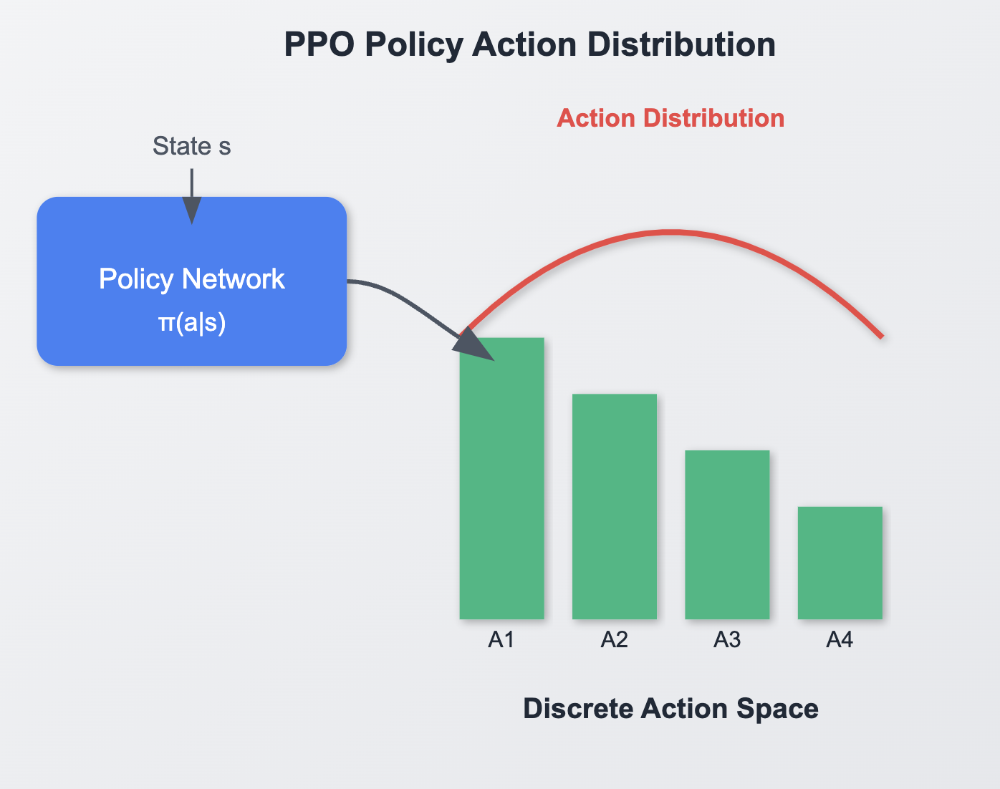
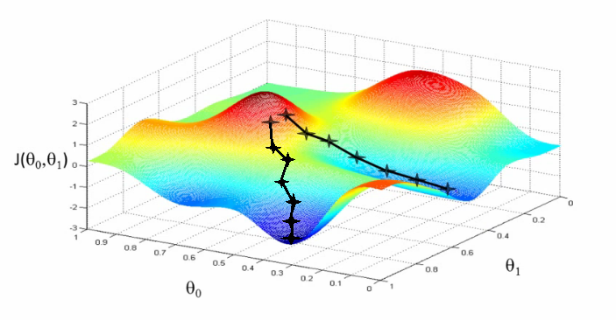
Directly learns a policy using gradient ascent to maximize reward.

Slide 6
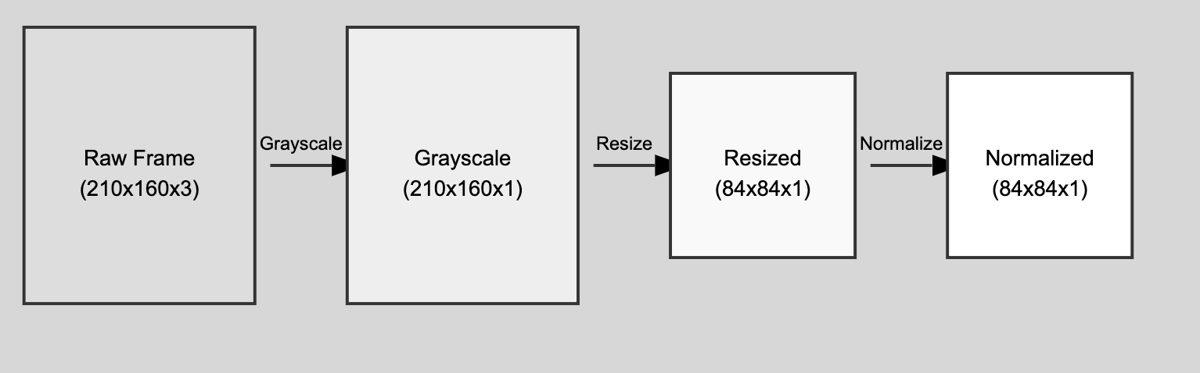
Preprocessing Frames

Slide 7
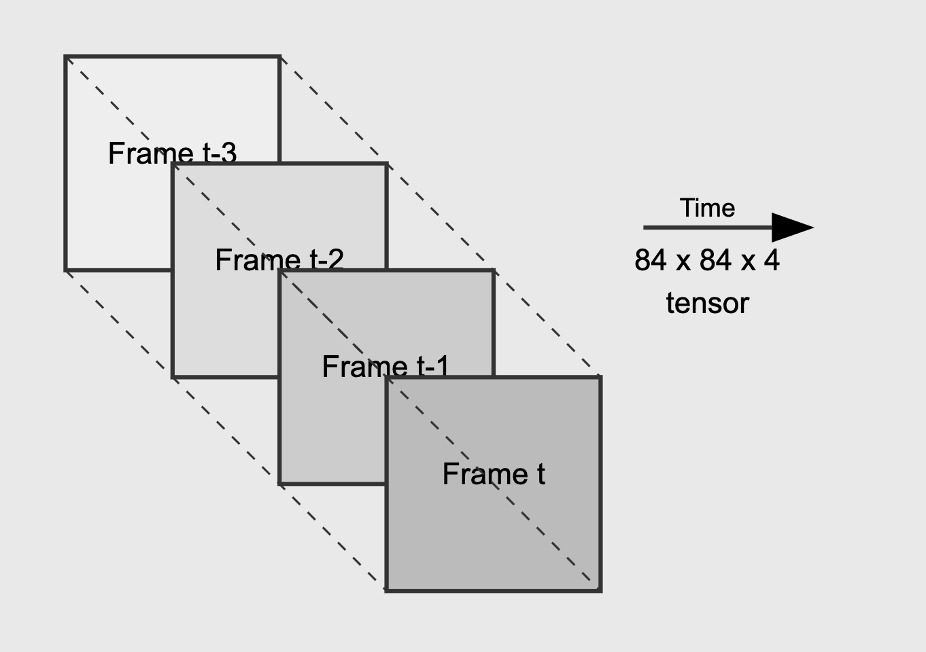
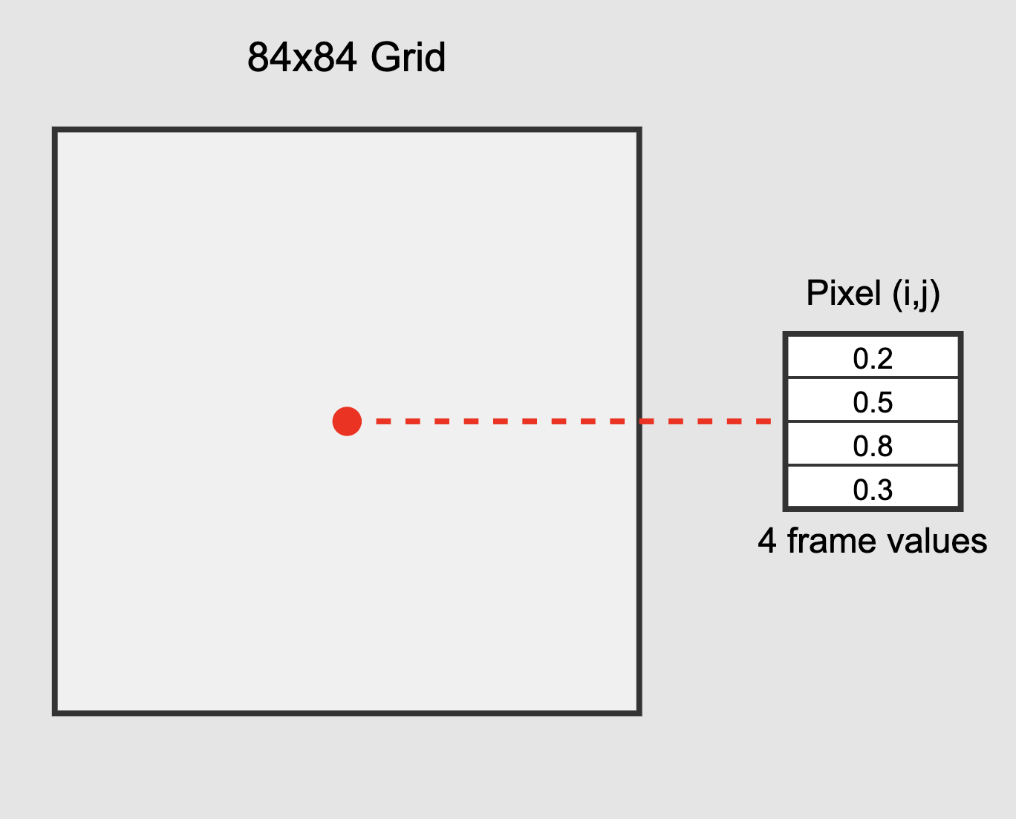
Stack Frames
Capture motion.
Deal with partial observability.
Provide Temporal context: It provides a short history of the game state
Our initial state can kind of be visualized then like:

Slide 8
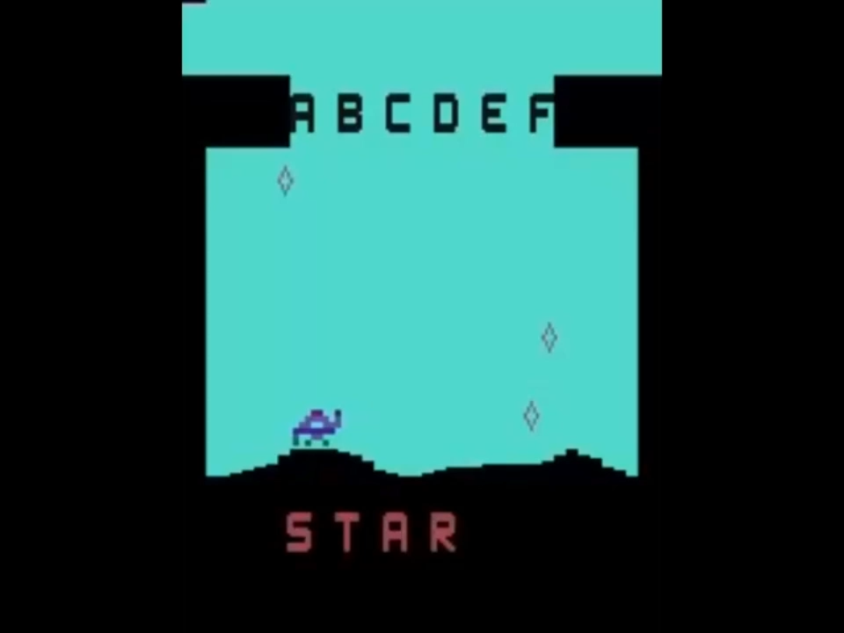
Demo Video

Slide 9
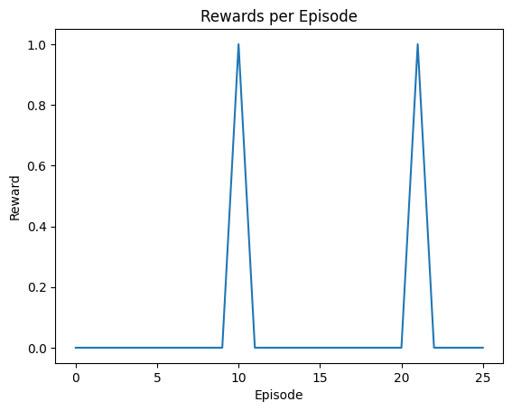
Visualization

